Slide 1
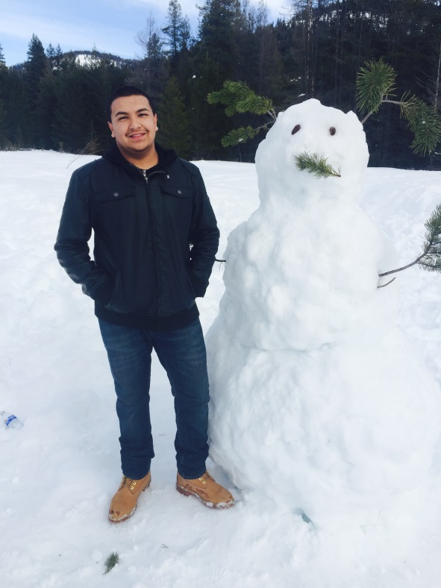
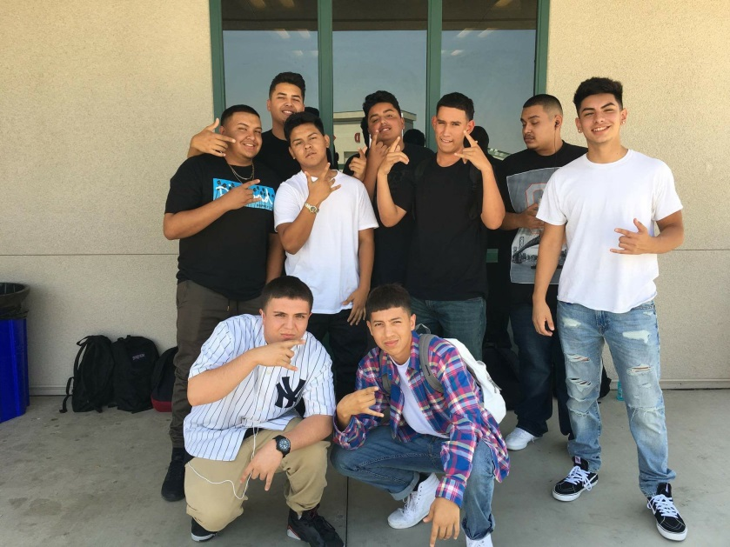
Gilberto Medina

Slide 2
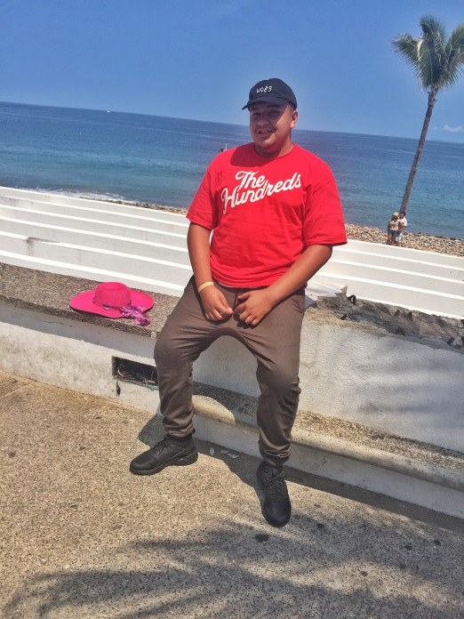
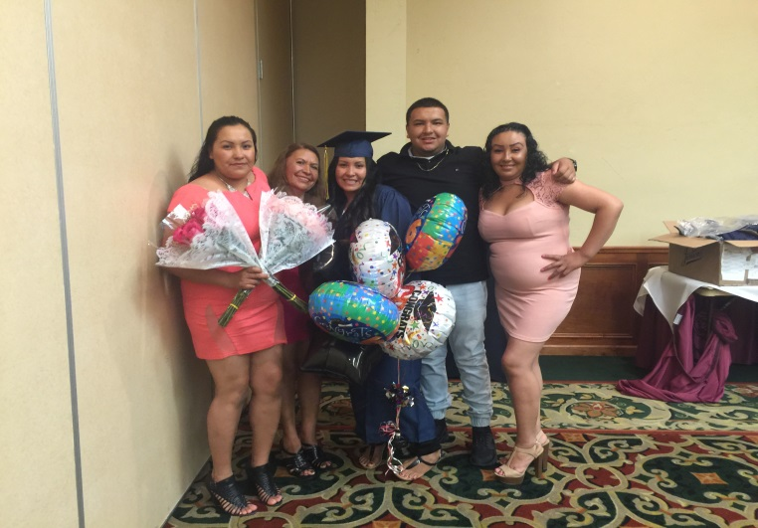
About Me
Born and raised in Lindsay, CA
17 years old
Youngest of 4
Dad passed away when I was 15
Sports, Music, Acting

Slide 3
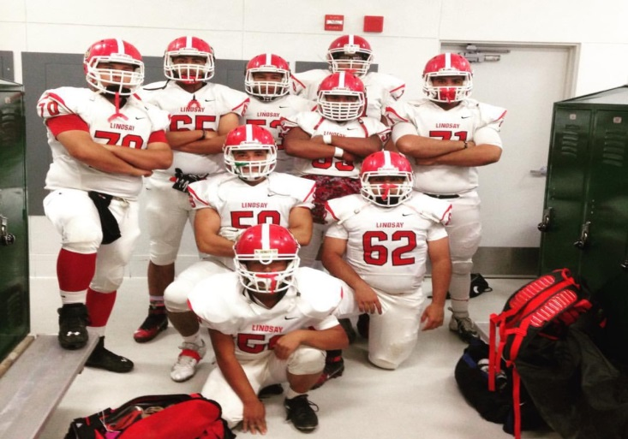
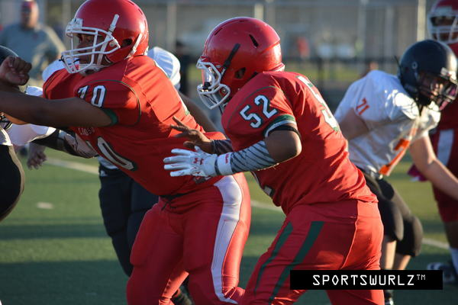
High School Experience
Football for 3 years
French club & Drama club
Biggest challenge is staying on pace and managing time
Taught me how to have an open mind and improved my communication skills

Slide 4
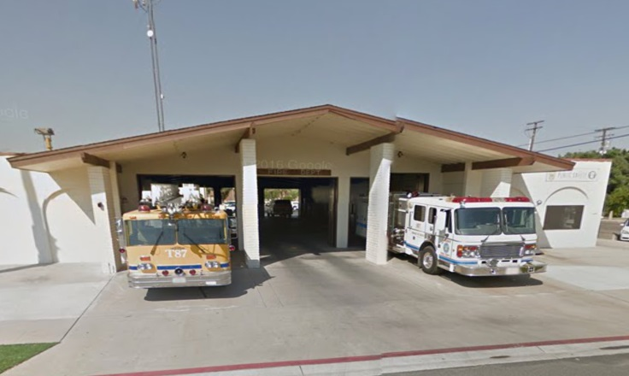
Job Shadow
Ride along with a Lindsay police officer
Jesse Cavasos
Stopped a couple people around town and made an arrest
Career in criminal justice

Slide 5
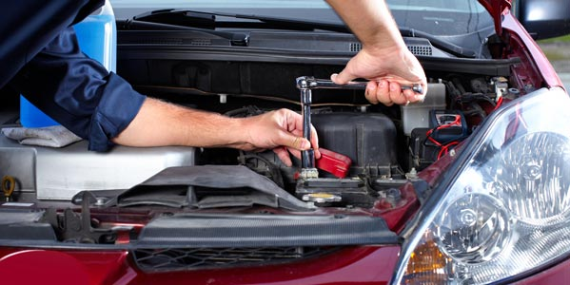
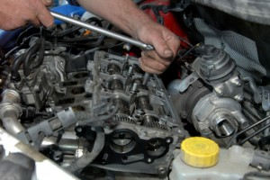
Pathway
Automotive Technology
Working on cars intrigued me
It has thought me not to give up
It does not relate to the career path I want to take

Slide 6
Post-High School Plans
COS then transfer to Fresno State University
Family support and financial aid
Short term goal is to become a police officer
Long term goal is to graduate college with a bachelor's degree

Slide 7
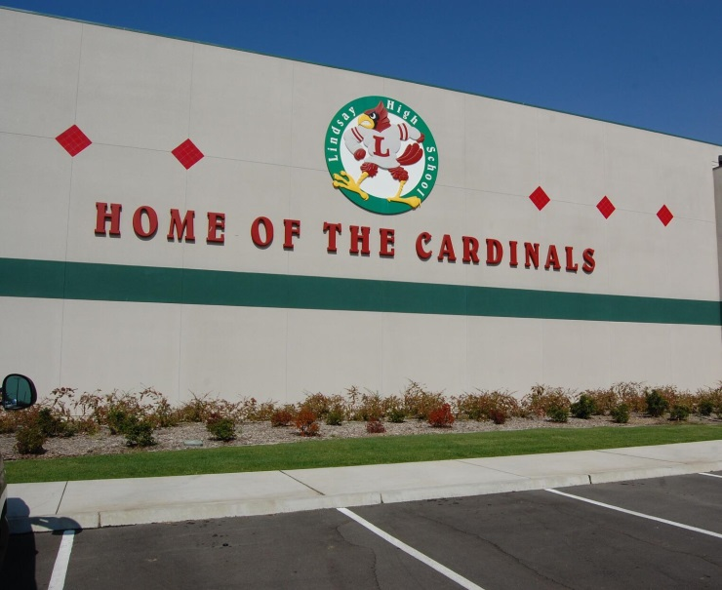
Leaving LHS
Dreams don’t work unless you do
LHS has shaped me into a more responsible person
Influential/helpful teachers:
Dr. Carr
Ms. Skinner
PBS has taught me:
Accountability
Independence
Determination
Time management

